Slide 1
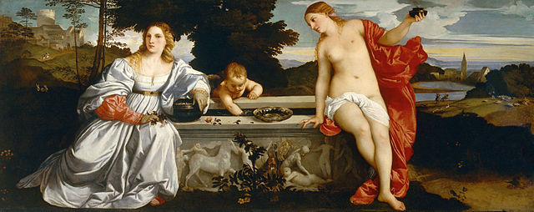
History 336
Ideas and Society in Early Modern Europe:
The Debate about Gender and Identity

Slide 2
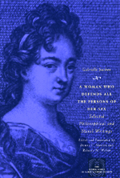
Gabrielle Suchon: Treatise on Ethics and Politics (1693)
Themes
Sources: Aristotle et al.
Who is responsible for women’s plight?
Philosophy and practice (p. 152)
Gender and difference (p. 157)
Logical and theological feminism
Continuities / discontinuities with other contributions to the debate about women and gender.

Slide 3
Questions to consider for the rest of the course
What passages strike you as historically significant? Mark them and write them down.
What positions on women and gender does a given primary source take on women and gender? How does the author support these positions?
Can you formulate at least one historical question based on the assigned reading to start a larger discussion?
Can you find a few secondary sources (and other primary sources) by using the library catalogue and databases that will help you answer your historical question?
Can you think of any current news stories that relate to women and gender?

